Slide 1
Transport in animals
What substances are transported?
Why is there a need for a transport system in multicellular animals?

Slide 2
Learning Objectives
the need for transport systems in multicellular animals to include
  an appreciation of size, metabolic rate and surface area to volume ratio (SA:V).
the different types of circulatory systems to include
  single, double, open and closed circulatory systems in insects, fish and mammals

Slide 3
Transport in animals
What substances are transported?
Oxygen
Nutrients eg glucose, amino acids
Hormones eg insulin
Waste products eg urea, carbon dioxide
(heat)

Slide 4
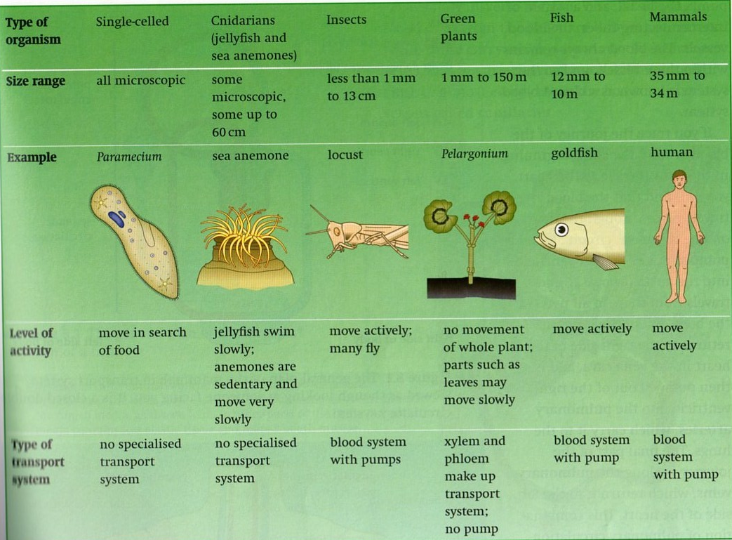
Different transport systems

Slide 5
Transport in animals
Why is there a need for a transport system in multicellular animals?
Size
As organisms get bigger, cells within the body are too far from the surface for diffusion to reach them efficiently

Slide 6
Transport in animals
Surface area to volume ratio
This decreases in larger animals therefore surface area is too small for diffusion to be fast enough

Slide 7
Transport in animals
Level of activity
most animals can move around and some (mammals and birds) can maintain body temperature which need high levels of glucose and oxygen for aerobic respiration to release the energy

Slide 8
Transport in animals
The bigger organisms become the more specialised areas of the body become.
  Eg some areas will specialise for gas exchange. Gases must then be moved around to all cells and tissues where they are required, and waste gases removed
  Food is absorbed in the gut then carried to all cells and tissues
  Excretion can be performed efficiently by organs such as kidneys

Slide 9
Features of efficient mass transport systems
Features of transport systems
A suitable medium

Slide 10
Features of efficient mass transport systems
Features of transport systems
A suitable medium
A pump to push fluid round under pressure

Slide 11
Features of efficient mass transport systems
Features of transport systems
A suitable medium
Vessels to carry medium
A pump to push fluid round under pressure

Slide 12
Features of efficient mass transport systems
Features of transport systems
A suitable medium
Method to maintain the flow in one direction
Vessels to carry medium
A pump to push fluid round under pressure

Slide 13
Features of efficient transport systems
Features of transport systems
A suitable medium
Exchange surfaces for substances to enter and leave
Method to maintain the flow in one direction
Vessels to carry medium
A pump to push fluid round under pressure

Slide 14
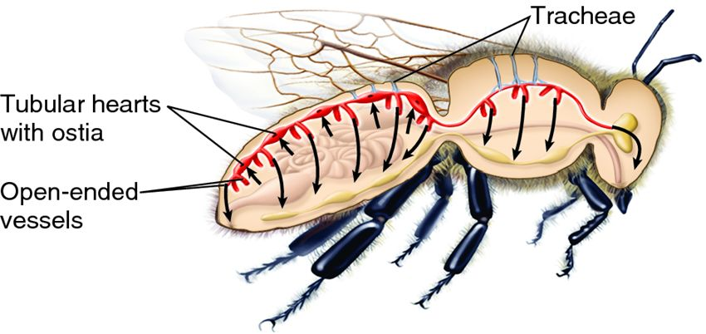
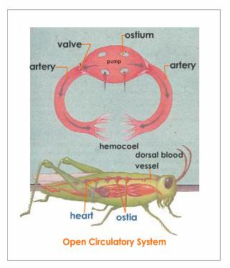
Open v. closed circulatory systems
Open circulatory system =
Blood does not always remain within vessels
eg .............................

Slide 15
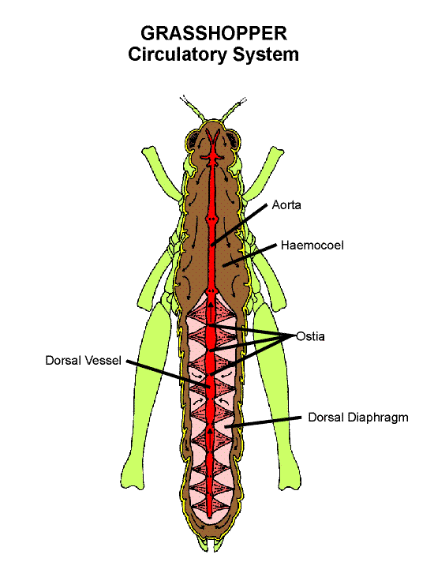
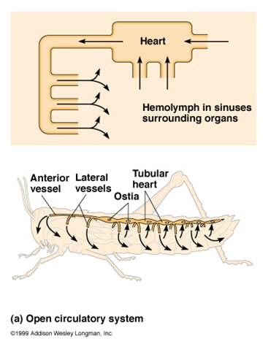
Open circulatory systems:
Insects have a pumping organ like a heart.
Blood enters ‘heart’ through pores (ostia).
Blood is pumped towards head by peristalsis.
At head end blood pours out into body cavity
Tissues/cells are bathed directly in blood
Blood remains at low pressure and flow is slow
Why does an insect have an open circulatory system?
Insects are small, blood does not have to travel far
They have a separate transport system for oxygen (tracheae)

Slide 16
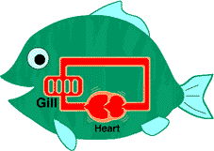
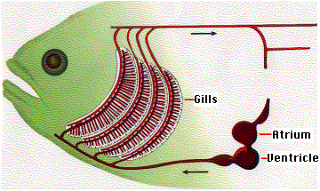
Open v. closed circulatory systems
Closed circulatory system =
Blood always remains within vessels (a separate fluid bathes cells – tissue fluid)
eg .............................
Why is a closed circulatory system needed in fish?
Larger
Heart can pump blood at a higher pressure so that it flows more quickly
Blood transports oxygen and carbon dioxide

Slide 17
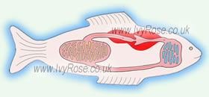
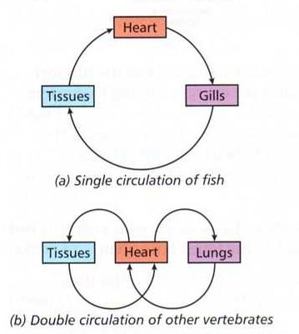
Single v. double circulatory systems
Single circulatory system =
Blood flows through the heart once during each circulation of the body
eg fish and annelid worms

Slide 18
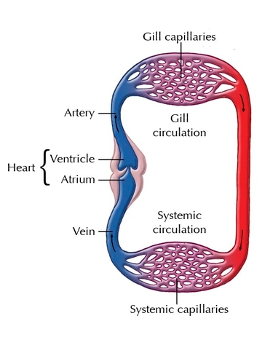
Single Circulations
Blood flowing through gill capillaries and organ capillaries experience great resistance due to the extensive contact with the capillary walls
Blood flow is slowed down, reducing the speed of exchange.

Slide 19
How do fish cope?
Reduced energy demands
  Poikilothermic (cold blooded)
  Water supports the body in movement
Countercurrent exchange system in the gills is very efficient at picking up O₂ and removing CO₂

Slide 20
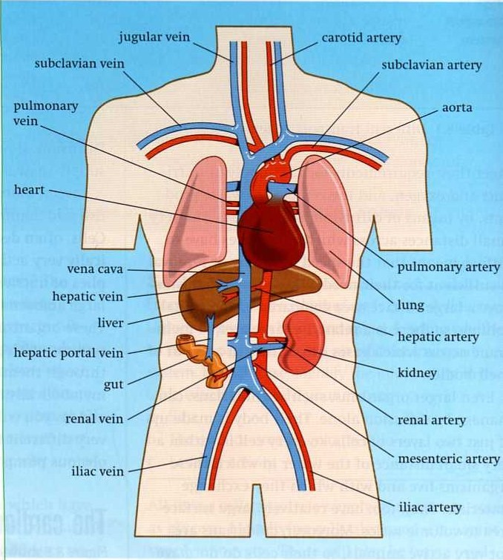
Single v. double circulatory systems
double circulatory system =
Blood flows through the heart twice for each complete circulation of the body
eg .............................

Slide 21
The Human Circulatory System is a Double Circulation
The heart pumps
oxygenated blood
TO the body tissues
and receives
deoxygenated blood
FROM the body
tissues
The heart pumps
deoxygenated blood
TO the lungs
and receives
oxygenated blood
FROM the lungs
This circuit in which
blood flows from the
heart TO the body
systems and back
to the heart is called
THE
SYSTEMIC
CIRCULATION
This circuit in which
blood flows from the
heart TO the lungs
and back to the
heart is called
THE
PULMONARY
CIRCULATION
The human circulation is a double circulation as there are two distinct
circuits along which blood flows

Slide 22
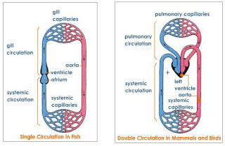
Comparing single and double circulations

Slide 23
Which system is the most efficient? Why?
Double circulation is most efficient
Heart increases pressure of blood after pressure has been reduced as it passed through the capillaries in lungs so blood will flow more quickly to body tissues
It is possible for flow to body tissues to be at higher pressure than flow to lungs (if pressure is too high in lungs capillaries could be damaged)
Why do mammals need a more efficient circulatory system?

Slide 24
double circulatory system
CAROTID
ARTERY
THE PULMONARY VEIN
AORTA
PULMONARY ARTERY
Smaller arteries branch
from the AORTA
VENAE CAVAE
CORONARY ARTERIES
HEPATIC
VEIN
HEPATIC ARTERY
The liver receives blood
from BOTH the hepatic
artery AND the
HEPATIC PORTAL
VEIN
HEPATIC
PORTAL
VEIN
RENAL ARTERIES
RENAL
VEIN
The hepatic portal vein transports blood, rich in the products of digestion, from the gut to the liver

Slide 25
double circulatory system
The CAROTID
ARTERY delivers
oxygenated blood
to the neck,
head and brain
THE PULMONARY VEIN
delivers oxygenated blood
from the lungs to the LEFT
ATRIUM of the heart
Deoxygenated blood
enters the right
ventricle from where
it is pumped to the
lungs along the
PULMONARY ARTERY
The oxygenated blood enters
the LEFT VENTRICLE,
which pumps the blood
along the AORTA towards
the body organs
Smaller arteries branch
from the AORTA in order
to deliver this oxygenated
blood into the various organs
Veins carry deoxygenated blood
away from the body organs. The
veins join to form two large veins
called the VENAE CAVAE
The CORONARY ARTERIES
deliver oxygenated blood to
the heart muscle
The VENAE CAVAE deliver
deoxygenated blood
to the RIGHT ATRIUM
of the heart
HEPATIC
VEIN
The HEPATIC ARTERY
delivers oxygenated blood to
the liver
The liver receives blood
from BOTH the hepatic
artery AND the
HEPATIC PORTAL
VEIN
HEPATIC
PORTAL
VEIN
The RENAL ARTERIES
deliver oxygenated blood
to the kidneys
RENAL
VEIN
The hepatic portal vein transports blood, rich in the products of digestion, from the gut to the liver

Slide 26
The history of circulation
Major blood vessels
History of understanding of human
circulation – interactive animation

