Slide 1
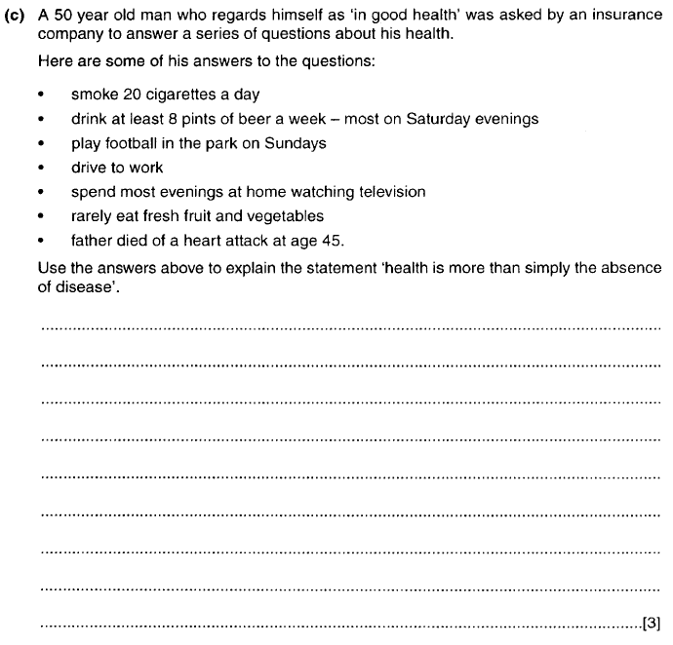

Slide 2
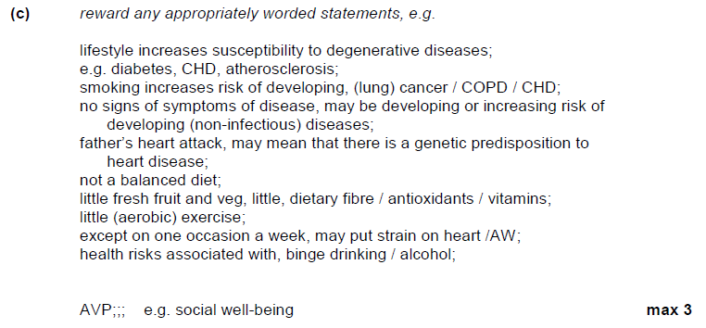

Slide 3
Communicable diseases, disease prevention and the immune system

Slide 4
What is a communicable disease?
A disease which is caused by a pathogen
Pathogens include bacteria, viruses, fungi, protozoa
Measles
Gangrene
Alzheimer’s
Coronary Heart Disease
Potato Blight
Malaria

Slide 5
How Pathogens Cause Harm
Damage the tissues
This is caused by pathogens entering cells and destroying them.
They may use the cell to provide raw materials to make new copies of themselves
This then disrupts the normal cell activity of the organism
Produces Toxins
These can act as inhibitors to enzymes or other processes that use proteins such as the protein receptors in a synapse
The toxins are often by-products of bacterial reactions

Slide 6
The different types of pathogen that can cause communicable diseases in plants and animals
Bacteria
  tuberculosis (TB)
  bacterial meningitis
  ring rot (potatoes tomatoes)
Virus
HIV/AIDS (human),
influenza (animals)
Tobacco Mosaic Virus (plants)
Fungi
black sigatoka (bananas),
ring worm (cattle), athlete’s foot (humans).
Protoctista
Malaria
potato/tomato late blight
PAGES 302-310

Slide 7
The means of transmission of animal and plant communicable pathogens
To include direct and indirect transmission,
  reference to vectors, spores and living conditions – e.g. climate, social factors
(no detail of the symptoms of specific diseases is required).
PAGES 305- 314

Slide 8
Independent Study
Read through these section and take any useful notes.
Do the summary questions on page 310.
You will be expected to apply your understanding to some past paper questions in next week’s lessons

Slide 9
Learning Objectives
the primary non-specific defences against pathogens in animals
  Non-specific defences to include skin, blood clotting, wound repair, inflammation, expulsive reflexes and mucous membranes
the structure and mode of action of phagocytes
  To include neutrophils and antigen-presenting cells
AND
  the roles of cytokines, opsonins, phagosomes and lysosomes.

Slide 10
Immunity
Non-specific system
Specific system
Barriers
Cells
Cells
Phagocytes
Mast cells
Lymphocytes
Humoral
Cell mediated
Neutrophils
Macrophages
B Lymphocytes
T Lymphocytes
Plasma cell
Memory cell
Helper
Killer
Suppressor
Antibodies
Cytokines

Slide 11
Non-specific system
present from birth
does not distinguish between different pathogens
gives the same response each time the same pathogen attacks

Slide 12
Barriers
Epidermis of skin
(layers of dead cells)
Mucous membranes
(protective layer secreted by goblet cells)
Chemicals such as
  Lysozyme in tears and urine
  Stomach acid

Slide 13

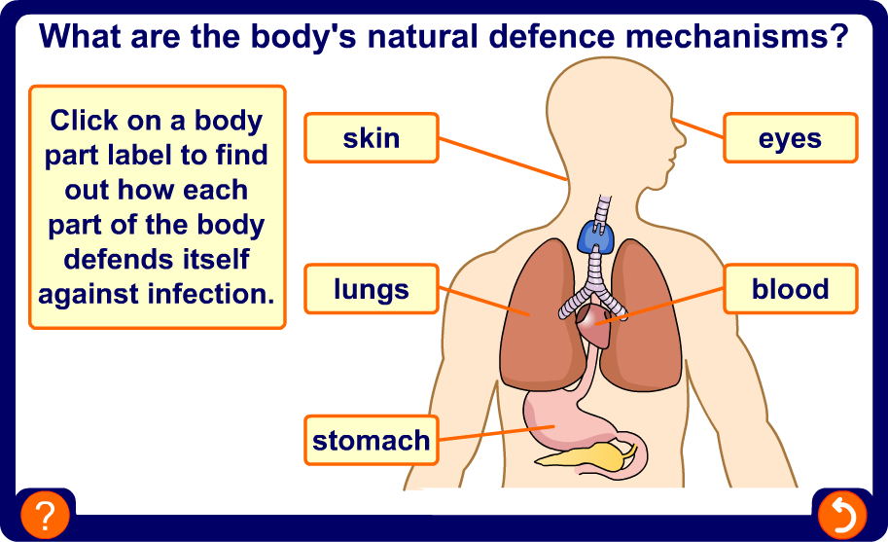
Primary defences

Slide 14
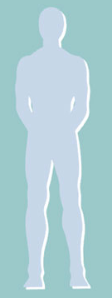
Physical barriers
A protective covering
Maintained by blood clotting
Epithelia covered in mucus
Blood clotting
Hydrochloric acid in the stomach

Slide 15
Lines of defence
The body has many different lines of defence:
physical and chemical barriers
most essential
non-specific
defences
pathogen-specific defences
most
controllable
inflammation
to attract white cells into tissues
ingestion of bacteria by white cells
involves antibodies and T- and B-cells

Slide 16
What triggers an immune response?
Antigens
These generate an immune response
These could be proteins or other molecules on the surface of cells, a molecule e.g. a toxin etc.
Our cells also have proteins etc. on the surface but they are not recognised by our own personal immune system as antigens
The system can tell the difference between you and non-you

Slide 17
Not always helpful
Can you think of one type of disease, two medical instances where being able to tell you from non-you is not helpful?
Blood transfusions, organ transplants, cancers

Slide 18
Phagocytes
White blood cells (leucocytes)
Continually produced from stem cells in bone marrow
Stored in bone marrow
Released into blood to engulf and digest foreign bodies
Two types:
Neutrophils and Macrophages

Slide 19
Neutrophils
60% of white blood cells
Smaller than macrophages
Numbers increase rapidly during infection
Move into tissues through leaky capillary walls
Short lived
Chemotaxic

Slide 20
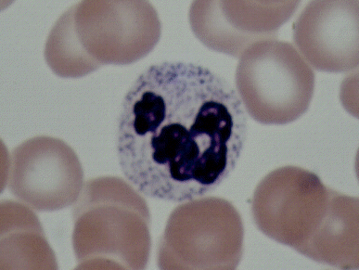
Neutrophil
(lobed nucleus)

Slide 21
Macrophages
4% of white blood cells
Larger than neutrophils
Circulate in blood and tend to remain in organs such as lungs, spleen, kidney, lymph nodes
Squeeze through leaky capillary walls
Phagocytic but play a role in initiating the specific immune system
Long lived

Slide 22
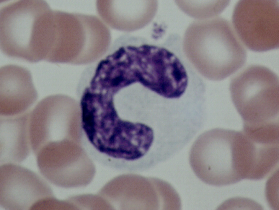
Macrophage or monocyte
(bean-shaped nucleus)

Slide 23
Opsonins
9 proteins released by liver and phagocytes eg Imunoglobulin (Ig) IgG and IgM
Normally circulate in blood in inactive state
activated in presence of bacteria and yeasts
Four mechanisms:
1. deposited on membrane of pathogen and make it porous
2. stimulate histamine release from mast cells
3. attract phagocytes to infection (chemotaxis)
4. opsonisation

Slide 24
Opsonisation
One end of complement protein binds to molecules on bacterial membrane
Other end binds to phagocyte
As phagocyte binds to complement proteins, the bacterial cell is engulfed
Bacterium
Bacterium
Phagocyte
Complement
proteins

Slide 25
Opsonisation or the Complement Cascade
The binding of an antibody to the surface of a pathogen can set of a chain reaction with blood proteins, which...
... causes the pathogen to swell up an burst.

Slide 26
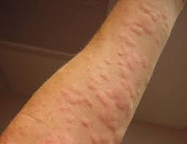
Mast cells
Granular cells found in connective tissue are activated when an injury occurs.
Release histamine
1. relaxes arterioles to increase blood flow
2. makes capillaries more leaky
3. attracts phagocytes
4. makes sensory neurones more sensitive
Release cytokines. These chemicals attract phagocytes to the site of the wound which engulf and digest the pathogens.
Rashes/hives are often visible during this process

Slide 27
Mode of action of phagocytes
Complement proteins released by the liver and phagocytes help the phagocytes to recognise pathogens
Phagocytes engulf bacteria (or other debris)
Ingested cells are enclosed in a vacuole
Lysosomes fuse with vacuole and release hydrolytic enzymes into it

Slide 28
Produced in bone marrow of long bones
Antibodies attach to antigens on bacterium
Proteins attach to antibodies
Surface of bacteria coated with proteins called opsonins (opsonisation)
Complement proteins from bacteria are attractant.
Neutrophils attach to opsonins
Neutrophils engulf bacterium into phagosome
Lysosomes fuse with phagosome
Forming a phagolysosome
Enzymes released
Soluble products absorbed

Slide 29
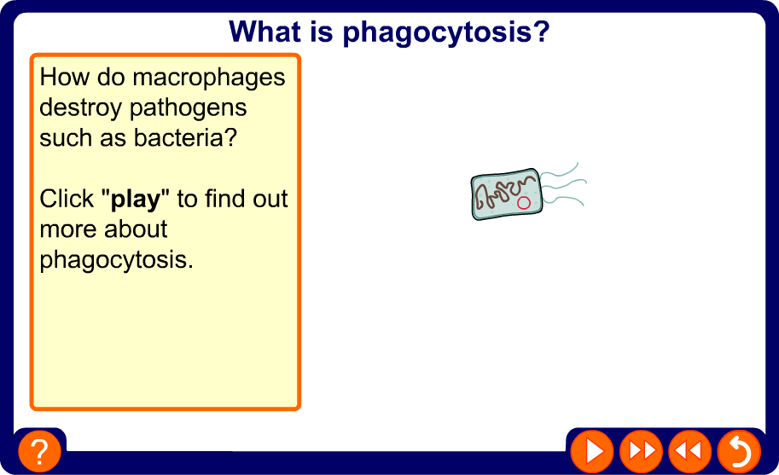
Non-specific responses to diseases

Slide 30
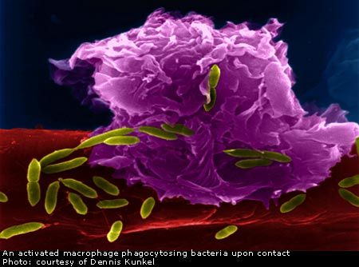
Phagocytes – a secondary defence
Examiners tip:
Phagocytes don’t eat microorganisms, they engulf and ingest them!
Neutrophils
Macrophages
Draw diagram and explain role of:
Phagosome
Lysosomes
Antigens
Antibodies
Receptors

Slide 31
Phagocytosis
Relatively quick for neutrophils(about 10 minutes)
Macrophages add another step
They become antigen presenting cells (APC)
  They combine the antigens from the pathogen with a glycoprotein from the macrophage Major Histocompatability Complexes (MHC )
  These are positioned on the cell surface membrane to signal to the lymphocytes
Lymphocytes are part of the specific immune response which ‘learns’ the antigens of the pathogen so that it can respond to it directly next time.

Slide 32
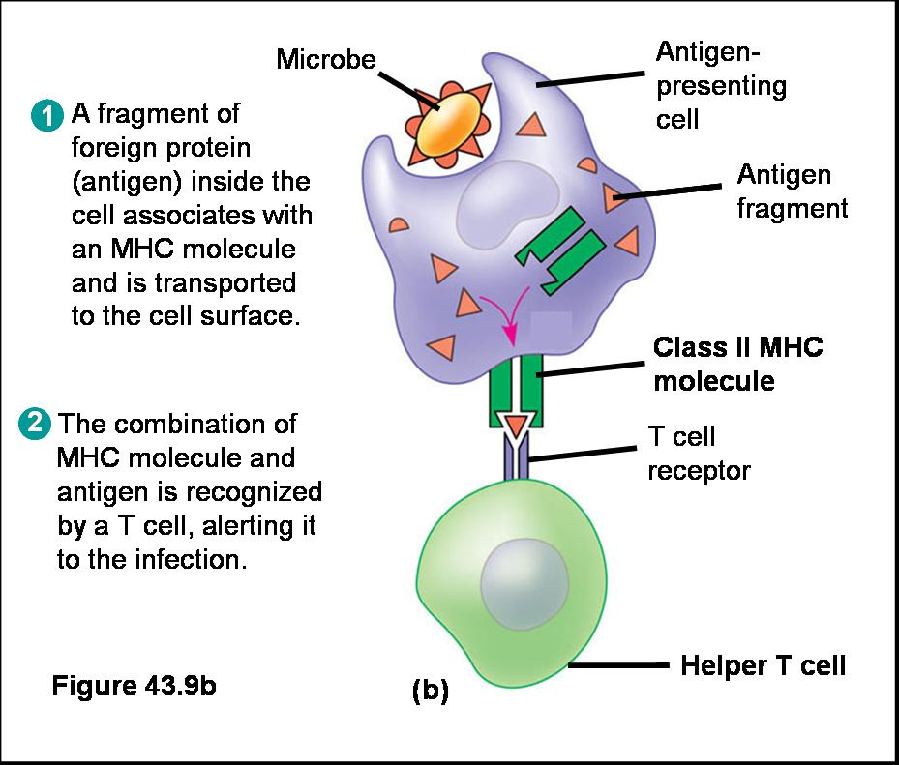
MHC = Major Histocompatability Complex
Lymphocyte

Slide 33
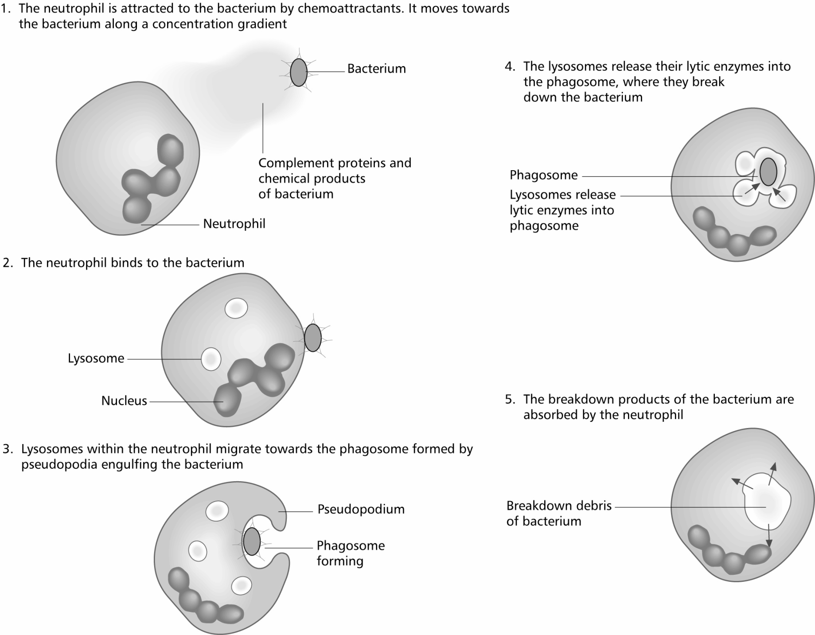
Phagocytosis – monocytes, macrophages and neutrophils

Slide 34
Cellular processes involved in phagocytosis
This process can be linked to other areas of the course
  Role of the cytoskeleton in moving the phagocyte- formation of the pseudopodia.
  Role of the cytoskeleton in moving the lysosomes towards the phagosome.
  Cell signalling using cytokines and MHC.
  Large numbers of mitochondria to provide ATP for endocytosis (engulfing the pathogen)and exocytosis when excreting the waste products.
  Enzyme activity involving the lytic enzymes in the lysosome.

Slide 35
Learning Objectives
the primary non-specific defences against pathogens in animals
  Non-specific defences to include skin, blood clotting, wound repair, inflammation, expulsive reflexes and mucous membranes
the structure and mode of action of phagocytes
  To include neutrophils and antigen-presenting cells
AND
  the roles of cytokines, opsonins, phagosomes and lysosomes.

